Slide 1



Introduction to GitHub Copilot
Advanced Features of GitHub Copilot
Exploring AI assistance in coding workflows
by RocketMind academy
Notes:
AI-generated content may be incorrect. --- GitHub Copilot is an AI-powered code completion tool that assists developers by suggesting code snippets and entire functions. In this presentation, we will explore its features, benefits, integration with development environments, and how to get started with it.

Slide 2
01
GitHub Copilot Modes Overview

Slide 3

Ask Mode
Purpose of Ask Mode
Ask Mode allows users to query their codebase using natural language, making it easier to obtain explanations and recommendations.
Use Cases
Common use cases include understanding code structure, finding relevant files, and explaining code logic.
Benefits of Ask Mode
Ask Mode provides quick insights without the need to modify the code, enhancing productivity.

Slide 4

Edit Mode
Purpose of Edit Mode
Edit Mode allows developers to make precise, context-aware edits while maintaining control over the code.
Use Cases
Common use cases include refactoring code, adding features, and fixing bugs all while ensuring developer oversight.
Benefits
Edit Mode provides precise suggestions for code changes, facilitating better code quality and efficiency.

Slide 5
Agent Mode
Autonomous Code Execution
Agent Mode enables the autonomous execution of multi-step coding tasks, streamlining the development process.
Debugging and Self-Healing
This mode can debug and fix runtime errors autonomously, offering self-healing capabilities for applications.
Terminal Command Suggestions
Agent Mode suggests and executes terminal commands, enhancing developer efficiency during coding and deployment.
Peer Programmer Benefits
By acting as a 'peer programmer', Agent Mode iterates on outputs to complete complex tasks end-to-end.

Slide 6
02
When to Use Each Mode

Slide 7

Comparison of Modes
Ask Mode
The Ask mode is best for quick answers and code exploration, enabling users to retrieve information efficiently.
Edit Mode
Edit mode is designed for targeted code changes, allowing users to make specific modifications as needed.
Agent Mode
Agent mode facilitates multi-step automation, helping users automate tasks like debugging and testing.

Slide 8

Summary of Modes
Ask Mode
Ask Mode simplifies code navigation, making it easier to understand complex code structures and logic.
Edit Mode
Edit Mode balances AI suggestions with developer control, ensuring precision in code editing and enhancements.
Agent Mode
Agent Mode excels at autonomous task completion, significantly reducing manual effort for complex workflows and tasks.
Dynamic Mode Combination
For optimal results, dynamically combine modes to leverage their strengths in diagnosing and resolving issues.

Slide 9
03
Extending GitHub Copilot in Your Organization

Slide 10

Installation and Usage
Extending GitHub Copilot
Organizations can enhance GitHub Copilot functionality by installing extensions from GitHub Marketplace, integrating external tools.
Eligibility for Extensions
Only organization owners with active Copilot Business or Enterprise plans can install extensions at the organization level.
Installation Steps
Key steps include setting policies, installing via GitHub Marketplace, and completing onboarding for extensions.
Custom Extensions
Organizations can create custom Copilot Extensions tailored to internal workflows by building GitHub Apps.

Slide 11

Benefits
Streamlined Workflows
Connecting Copilot to various tools enhances efficiency by streamlining workflows across CI/CD pipelines and documentation systems.
Security and Governance
Microsoft Purview protections ensure that enterprise users maintain security and governance across their data and tools.

Slide 12
04
Customizing GitHub Copilot Chat Responses

Slide 13

Personal Custom Instructions
Tailored Chat Responses
Users can customize Copilot responses to match personal preferences and project requirements, enhancing coding efficiency.
Personalized Rules
Setting personalized rules like coding styles and preferred frameworks helps Copilot generate relevant and preferred responses.
Integration with Workflows
Custom instructions ensure that AI-generated code integrates smoothly into existing workflows while maintaining quality.

Slide 14

Repository-Specific Instructions
Contextual Guidance
Creating a `.github/copilot-instructions.md` file offers specific instructions and guidelines for your project.
Frameworks and Libraries
Specify frameworks and libraries used in the project to ensure consistent coding practices among team members.
Domain-Specific Logic
Provide instructions for prioritizing certain technologies or methodologies relevant to the project's domain.
Code Structure Rules
Establish rules for code structure to maintain consistency across all contributions, such as docstring formats.

Slide 15

Model Flexibility
Model Switching
Copilot Chat allows users to switch models during interactions to improve response quality for different tasks.
Task Adaptation
Users can adapt the model for specific tasks like code generation or debugging, enhancing productivity.
Full-Stack Development
The flexibility of model switching benefits full-stack developers working with different technology stacks.

Slide 16

Prompt Engineering
General Prompts
General prompts provide broad instructions that can yield versatile responses, useful for various tasks.
Specific Prompts
Specific prompts are tailored to produce precise outputs, beneficial for specialized development needs.
Contextual Prompts
Contextual prompts use references to existing code, helping align responses with ongoing project standards.

Slide 17
05
Adding Personal Custom Instructions

Slide 18
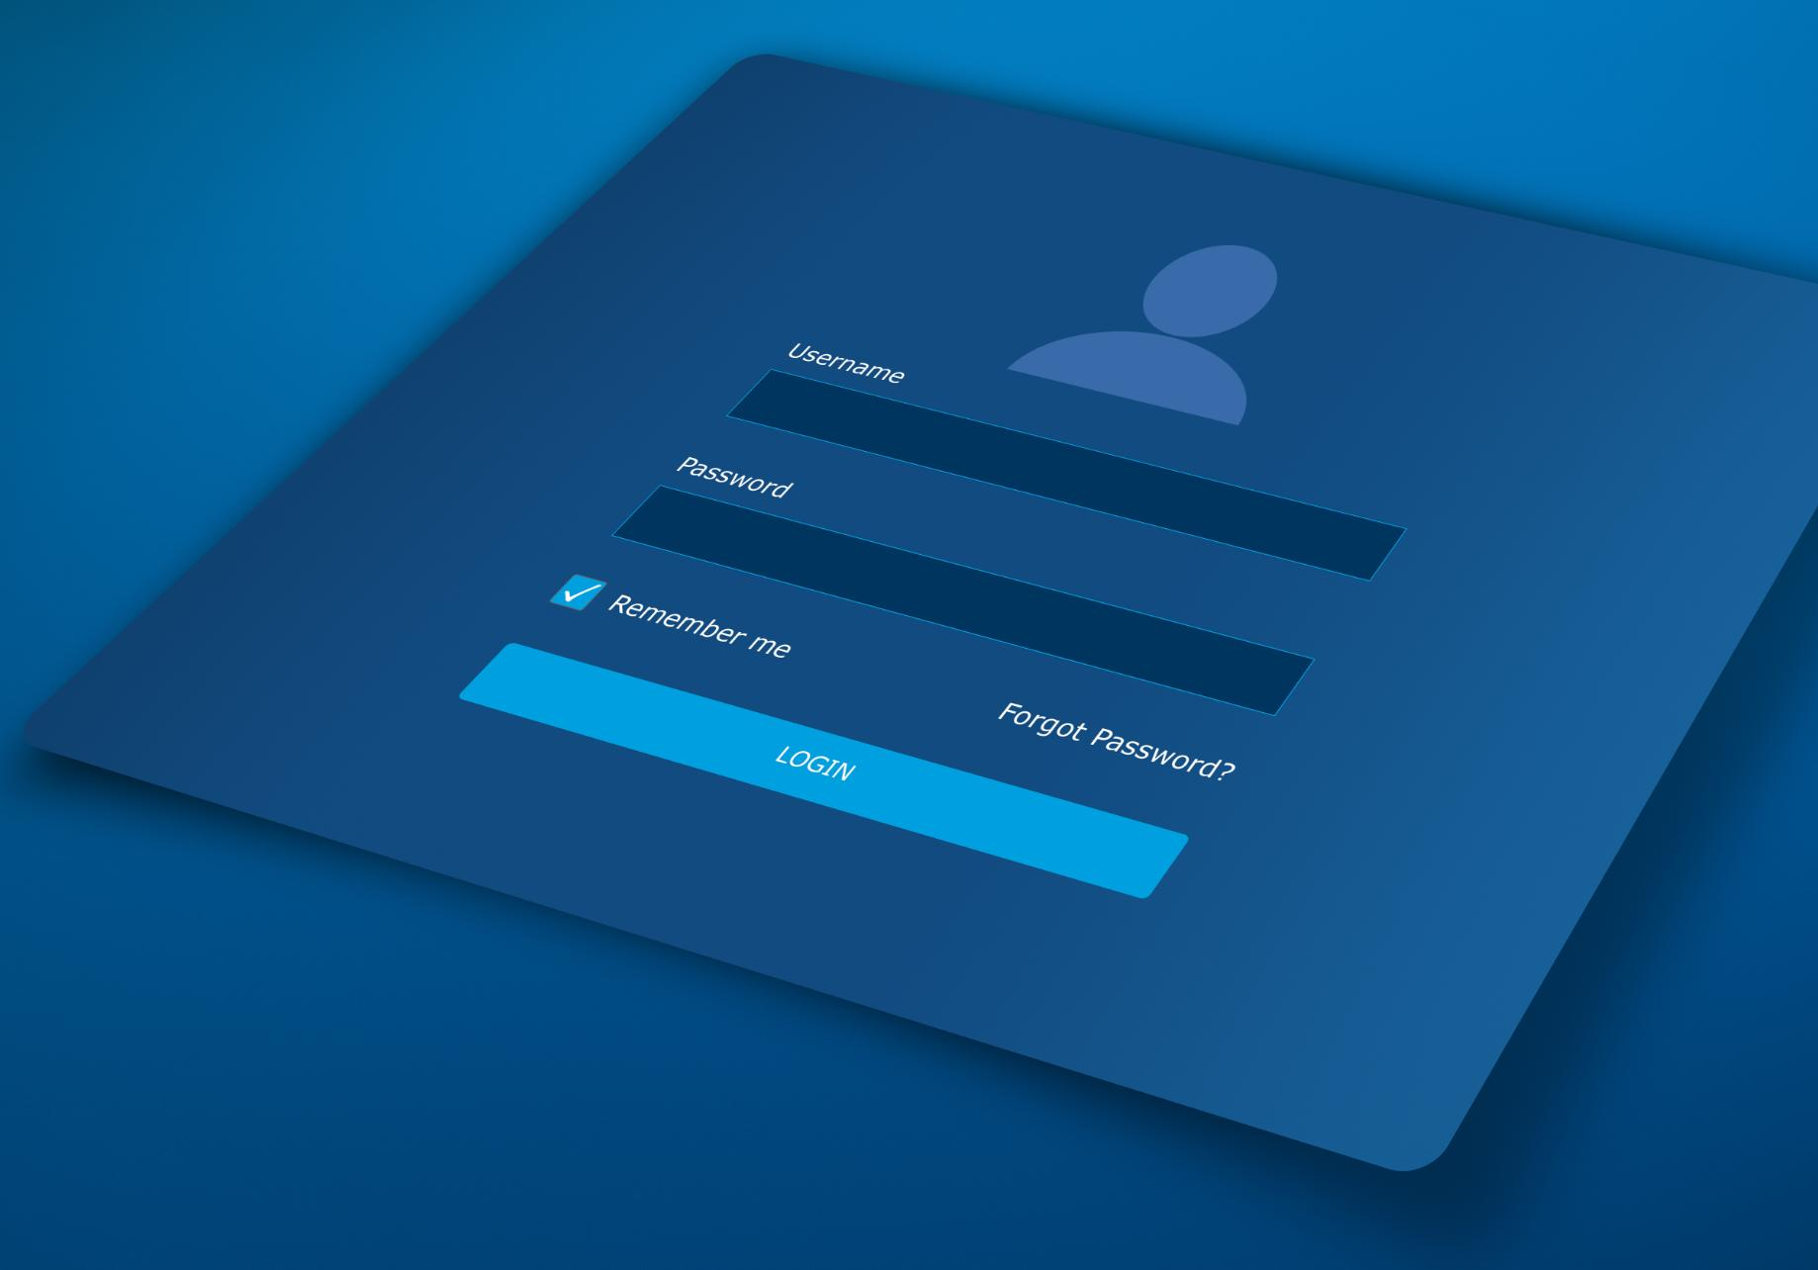
Steps to Add Instructions
Understanding Custom Instructions
Personal custom instructions allow you to tailor GitHub Copilot Chat responses to your preferences, enhancing the coding experience.
Accessing the Chat Panel
Start by clicking the GitHub Copilot icon to open the Chat panel or access immersive mode for a full experience.
Setting Your Instructions
In the Chat panel, use the dropdown menu to enter your personalized instructions using natural language.
Saving and Testing Instructions
After entering instructions, click save. Test them by starting a new conversation within GitHub Copilot.

Slide 19

Priority and Scope
Understanding Priority
Personal instructions take precedence over organizational rules, ensuring tailored responses. Avoiding contradictions is essential for clarity.
Defining Scope
These priority settings are applicable specifically to GitHub Copilot Chat on GitHub, not for other integrations like VS Code.

Slide 20
06
Adding Repository Custom Instructions

Slide 21

Steps to Add Instructions
Creating the Instructions File
In your repository's root directory, create the file '.github/copilot-instructions.md' to hold your custom instructions.
Using Markdown Format
Add your custom instructions in Markdown format, allowing for clear and structured guidelines tailored to your project.

Slide 22

Examples and Best Practices
Examples of Instructions
Provide clear examples to guide developers on specific coding practices like using React with TypeScript.
Supported Environments
Identify environments where the best practices and instructions can be effectively applied, such as Visual Studio and VS Code.
Best Practices
Emphasize the importance of specificity and conciseness in instructions to avoid ambiguity in software development.

Slide 23
07
Extending Copilot Chat with the Model Context Protocol (MCP)

Slide 24

Key Features and Prerequisites
Connectivity with External Tools
MCP enables seamless interaction between AI models and various external data sources, enhancing functionality.
Automated Workflows
Automation through MCP streamlines processes by allowing Copilot Chat to perform tasks without user intervention.
GitHub Copilot Access
Access to GitHub Copilot is a prerequisite for using MCP features effectively through subscription or trial.
Visual Studio Code Requirement
MCP support is limited to Visual Studio Code v1.99 or higher, making it essential for integration.

Slide 25

Configuring MCP Servers
Repository-Level Setup
Define MCP servers by creating a `.vscode/mcp.json` file with the necessary configurations for the project.
Activating the Server
After setting up the configuration, click the 'Start' button in the `mcp.json` editor to activate the server.
Personal Configuration
Enhance functionality by adding settings in the `settings.json` file to enable discovery of existing MCP configurations.

Slide 26
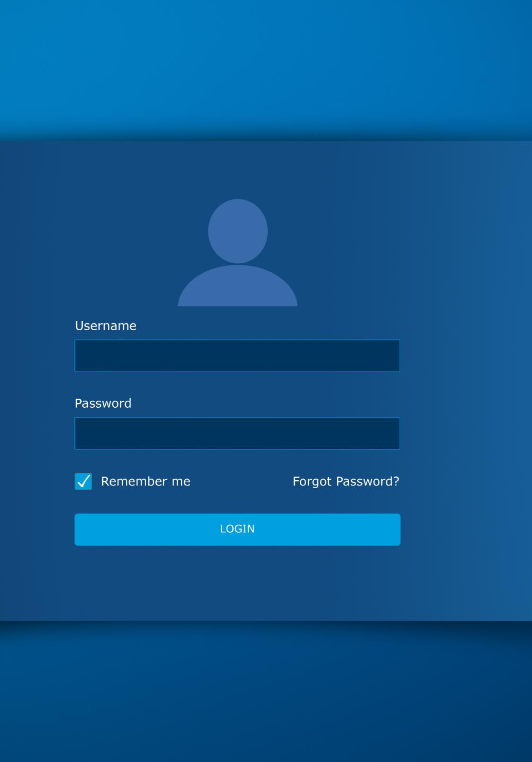
Using MCP Servers
Enable Agent Mode
To start using MCP servers, first enable Agent Mode in Copilot Chat within VS Code for seamless communication.
Natural Language Prompts
Utilize natural language prompts to interact with MCP servers, making requests like fetching web content effortlessly.
Accessing Tools
MCP server tools can be accessed via the tools icon in the chat window, providing various functionalities.

Slide 27

Creating Custom MCP Servers
Tailored MCP Servers
Developers can create customized MCP servers that connect Copilot Chat to various internal systems, enhancing functionality.
Defining Server Logic
The first step is to define the server logic using the MCP specification to ensure proper integration.
Integrating with Copilot Chat
The second step involves integrating the server with Copilot Chat using the `.mcp.json` configuration file.

